Slide 1


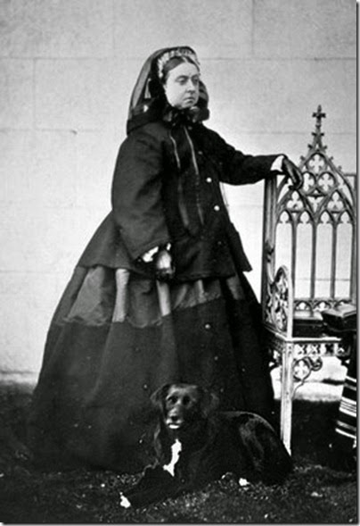
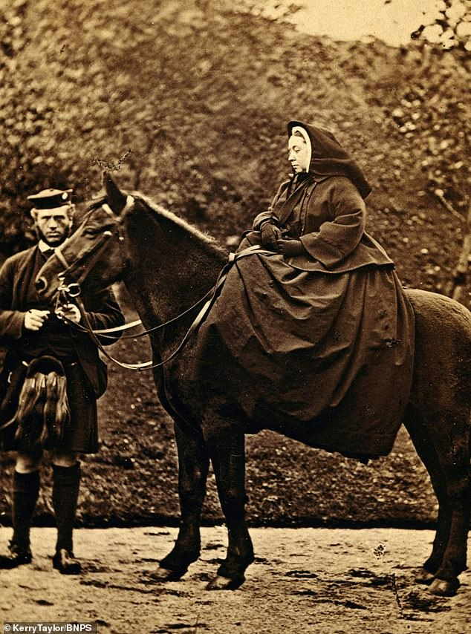
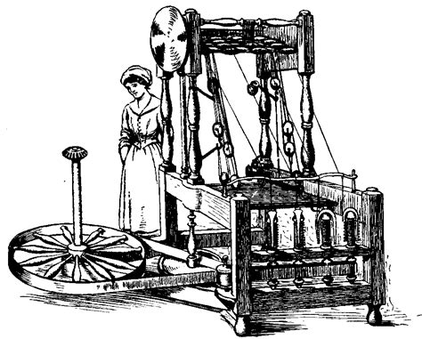






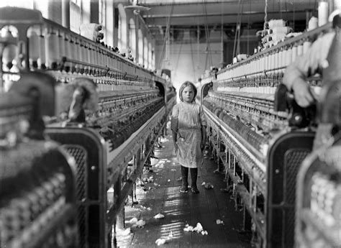
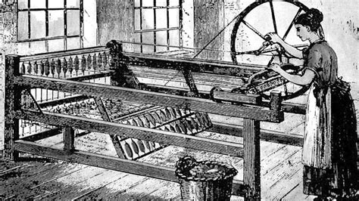
Introduction to women’s fashion 1800 onwards
History of nurse’s uniforms
Women’s fashion during the 1800s changed mainly with hemlines, waistlines and the introduction of hats from decorated linen caps and capes.
Dresses were made of linen and lace at the start of the decade, with flouncing and ruching with embellishments to emphasise the backs with a bustle, alongside introduction of trains.
Women’s fashion developed from horsehair and whalebone to the introduction of metal boning in corsets. Alongside the development of a light metal spring hoops for the crinoline (a metal cage supporting the skirt) underneath the hoop skirts in a bell shape, many petticoats in the late 1840s.
By the end of the decade, sleeves got tighter, and necklines got higher with A-line, smaller, skirts. Alongside accessories such as hats with trimming worn squarely on their heads, and parasols.
Nursing was acknowledged as a profession the 1800s with a high collared-shirt, floor-length dress and a bonnet. With influence from nuns' uniforms and the origin of calling a nurse sister.
In the 1900s after Florence Nightingale’s influence on the role, uniforms became more practical and distinguished the different roles and the hierarchy with different colours and symbols.
1800s nurse uniforms
Florence Nightingale and other 1900s nurses
Queen Victoria’s influence on fashion
British Textile Industry
Queen Victoria requested that all her clothes and the clothes of courtiers be of British manufacture, boosting the British textile industry. This attention to the British industry heightened the demand of these mass-produced products, increasing output and boosting the British economy. The bell-shaped dress was introduced in the Victorian era, moving away from the wide skirted dresses of the Georgian era and the high waistlines of sleek Regency era dresses.
Victoria remained in mourning attire from 1861, following the death of Prince Albert, until her death in 1901. In the 1800s mourning attire needed to be plain and conservative, with the introduction of more elaborate with strict rules with veils and drop earring became common. In 1840, The Workwoman’s Guide detailed expected mourning times for loss of relatives.
“Advances in textile manufacturing combined with a new consumer appetite for mourning apparel led to the establishment of stores – like Besson & Son in Philadelphia and Jackson’s Mourning Warehouse in Manhattan – that sold ready-made mourning clothes, while department stores like Lord & Taylor added mourning departments.” Jocelyn Sears for Racked.
The East India Company was founded in 1600 and dissolved in 1874. This company produced the cotton goods for Britain, Calico and chintz was substitute for Indian wool and linen. Creating local weavers, spinners, dyers, shepherds and farmers with a petition to their MPs for Parliament to ban importation of textiles and later the sale of woven cotton goods. Which was achieved with the 1700 and 1721 Calico Acts.
With the invention of the Spinning Jenny and water frame quality of thread increased, with less reliance on wool or linen to wake the warp, and had the waterpower needed to operate larger machines.
In the 19th century, Britain became the world’s leading cotton textile manufacturer with support of Queen Victoria and her insistence on the use of British textiles, weavers, and mills. Ports on the west coast such as Liverpool, Bristol and Glasgow were important parts of the cotton industry.
Gloucester canal and its railway increased its economic success with links to Gloucester’s hinterland. In the 1800s the “five-valleys” of Stroudwater, Little Avon/Doverte Brook and the Ewelme/Cam, had almost 200 mills during early Industrial Revolution.
1840s-1900s Fashion – Victoria & Albert Museum
Queen Victoria c.1860-1870
Water frame
1800s textile mill
Spinning Jenny

Slide 2
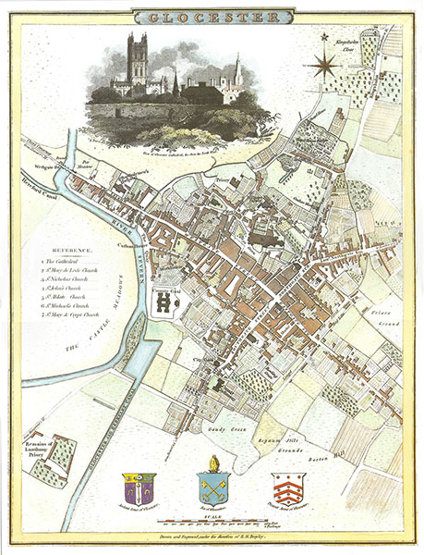
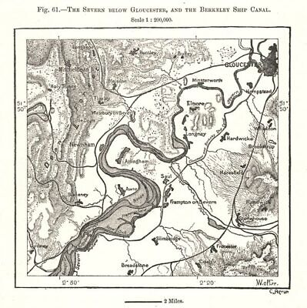
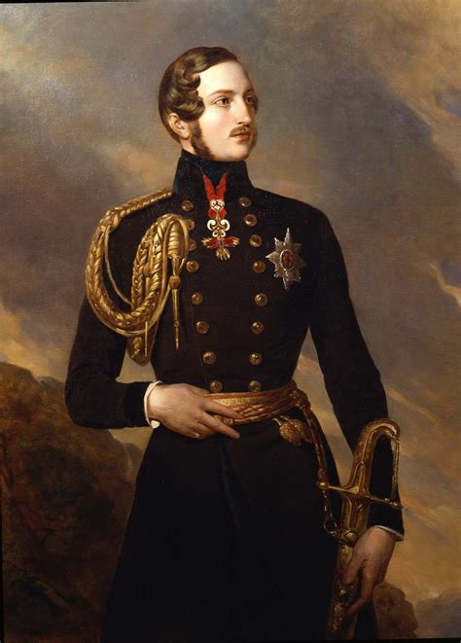
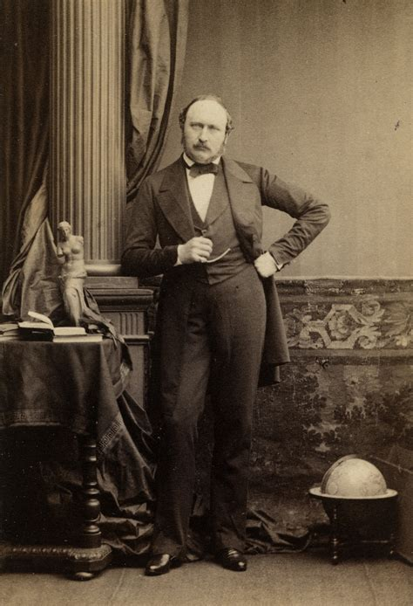

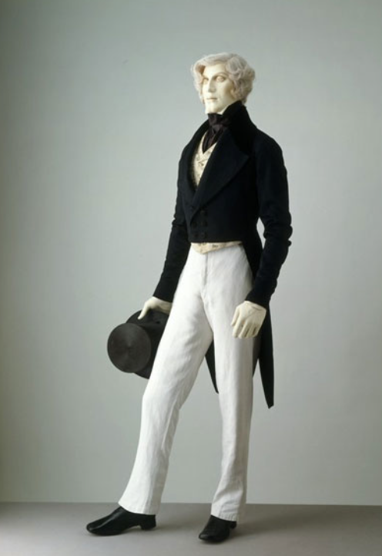

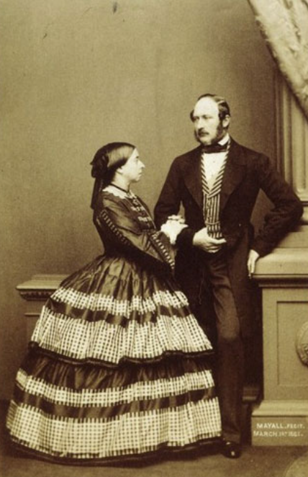


Introduction to men’s fashion 1800 onwards
Gloucestershire trade
Men’s fashion in the 1800s, the fitting of suit jackets and coats started off with cinched waists creating an hourglass figure to emulate Prince Albert.
In the 1850s shirts had collars tied with large bowties and bowler hats, also known as the working-class hat while upper class men wore top hats. Jackets and coats length moved down from the hip to mid-thigh and the 1870s introduced semi-fitted jackets buttoned high.
The 1880s focused on the buttoned waist coat rather than the jackets and neckties and bowties around the high collars. By the end of the decade men moved away from frock coats which were popular with more conservative men as the three-piece longue suits gained popularity.
‘In the mid 19th century, the trade brought by the Gloucester and Berkley canal was of primary importance to the economy, and the building of railways improved links with Gloucestershire’s hinterland.’
Within the county, timber yards, flour mills, engineering works, and manufacturers ranging from railway wagons to matches were among its industries. With metal and engineering trades with at least 434 employees, the city also depended on employment of builders, the provision of food and clothing, and domestic service.
Gloucester’s former staple industry of pin making, with a largely female workforce, the county faced strong competition from other places by the 1830s, and the removal of patent restrictions which led to collapse. Of the surviving firms, one ceased production before 1841 and the other in the 1850s.
Gloucestershire’s river and canal trade was assisted by stem tugs on the Severn from the mid 1850s. Alongside new markets for cheese, wool, and hides established in the 1850s then a new produce market and corn exchange were built in 1856.
Leather traders were represented by curries, fellmongers, a glover, saddlers, and numerous boot and shoemakers, of whom one had 24 employees in 1851.
Prince Albert’s influence on fashion
Albert fashioned an hourglass figure with cinched waists that influenced Britain during his reign from 1840 to 1861.
Men’s hairstyles and facial hair in the 1850s, entailed large mutton-chops side-burns and moustaches influenced by Prince Albert. Moustaches were not popular in England until the reign of Prince Albert and were fashionable from 1860.
The Crimean campaign/wars led to soldiers to being infected due to razor cuts leaving many men dead, with the army leaders beginning this trend in order to inspire the troops and prevent more deaths by infection then became popularised in England on the soldiers’ return.
Prince Albert c.1840-1860
1840s-1900s Fashion – Victoria & Albert Museum
Map of the Severn below Gloucester c.1800s
Map of 1800s Gloucester

