Slide 1
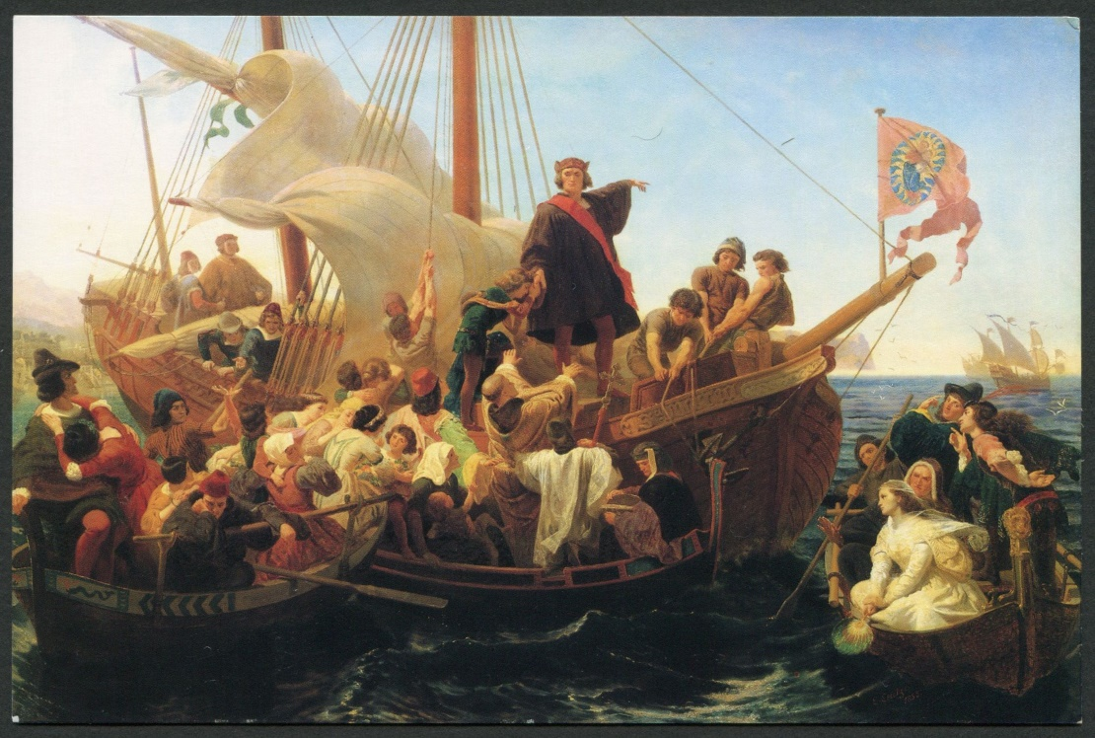
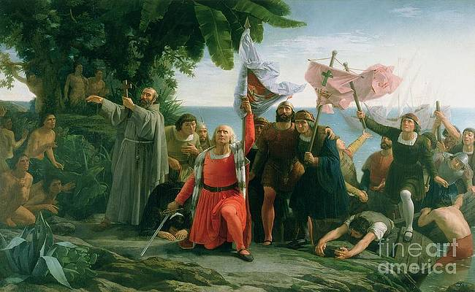
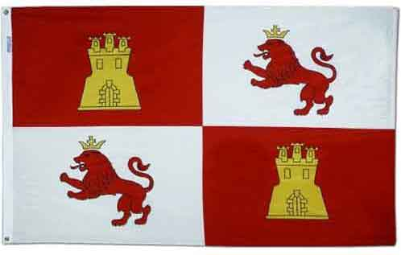
1800s
Both these paintings depict Christopher Columbus in a positive light, as a ‘martyr’* and saviour of the Americas and expanded and maintained the Spanish empire.
The religious element of these examples of Columbus reinforces the idea that Columbus saved and purified the Americas with the spread of Christendom.
Gottlieb’s painting represents the support of Columbus by the Spanish with men, women, and children praising him for his journey from Palos. Among the crowd there are monks, emphasising the religious implication of Columbus’ journey and invasion. Columbus’ departure from Palos was the catalyst to Spanish exploration then further European expansion into the “New World”.
The Departure of Columbus from Palos in 1492 by Emanuel Gottlieb (1855)
With Tolin’s painting having Columbus in his knee before God and the explorers bringing light to the “new” continent with Christian symbolism and the expansion of Spanish domain. While the natives are hidden among the land, in the dark – which could represent the lack of Christianity and “civilisation” pre-Columbus’ invasion.
19th century paintings reflected a European perspective of this “discovery” and how it impacted Christendom and the Empires, and the pride Columbus had, and he raised the Lions and Castles Flag – representative of the unification
of two houses – suggesting the support of the Monarchy.
The First Landing of Christopher Columbus by Dioscoro Teofilo Puebla Tolin (1862)
*The West as America: Reinterpreting Images of the Frontier, 1820-1920, exhibition catalogue, Washington D.C., (1991) p.76

Slide 2
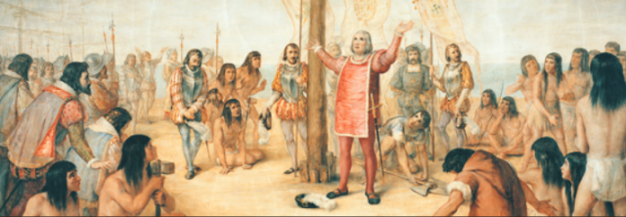
‘Notre Dame Will Cover Columbus Murals’ by Scott Jaschik, 2019
The paintings in the main building of the university was ’for many years a point of pride to Roman Catholic students and alumni’ with this being representative of the Catholic population of America and the ‘American hero’ Columbus. Now the university are going to ’make high-quality reproductions available elsewhere… with more historical context.’, addressing the societal and cultural impact that Christopher Columbus’ discovery had on the Native American community.
“Columbus was hailed by Americans generally as an intrepid explorer, the 'first American' and the 'discoverer of the New World.' Gregori’s murals focused on the popular image of Columbus as an American hero, who was also an immigrant and a devout Catholic.”
“The message to the Notre Dame community was that they too, though largely immigrants and Catholics, could be fully and proudly American."
Reverend John I. Jenkins, president of the university
’the encounter [between native and European cultures] was a harsh and painful reality for your peoples. The cultural oppression, the injustices, the disruption of your way of life and your traditional societies must be acknowledged.’
Pope John Paul II, 1987 meeting with the Native Peoples of the Americas
Painted by Luigi Gregori from 1882-1884 – Artist in residence and professor at the University of Notre Dame

