Slide 1


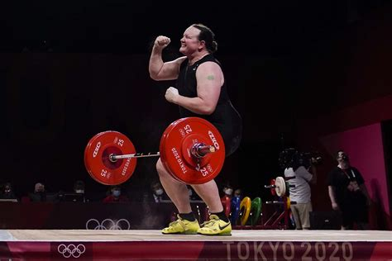
Transgender people in sport
The first Olympic event specifically designed for LGBT sportspeople was at the 1976 Montreal Games – three events
Trans men can compete without restriction while trans women will have to demonstrate lowered hormone levels for at least a year before competing
Most if not all sport doesn’t allow intersex athletes to compete
1960s: Visual genital inspections were used to confirm gender, then a chromosomal analysis – these body inspections became a mandatory step for women who wanted to compete
In 2020, Chris Mosier became the first openly transgender man to complete in a male Olympic trial
At the 2020 Summer Olympics, Quinn became the first openly transgender and nonbinary person to win a gold medal
In 2021, Laurel Hubbard became the first openly transgender woman to compete in female Olympic events, winning no medals in weightlifting.
Disproving the transphobic/transmisogynistic reason for not allowing trans athletes, specifically women, to compete because they have a “biological advantage”
In 2022, Kentucky forced a trans sport ban through legislature even though there’s only one known trans student athlete in the whole state
In 2003 the International Olympic Committee allowed transgender people to participate if:
They’ve undergone sex reassignment surgery including genitalia
Have legal recognition of their gender
Undergone hormone therapy for a suggested two years before participation
https://xtramagazine.com/power/politics/kentucky-trans-kids-sports-ban-221391

Slide 2
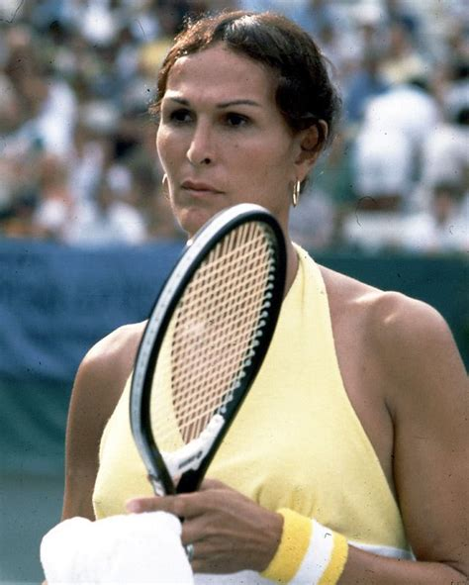
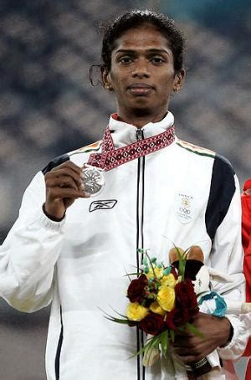
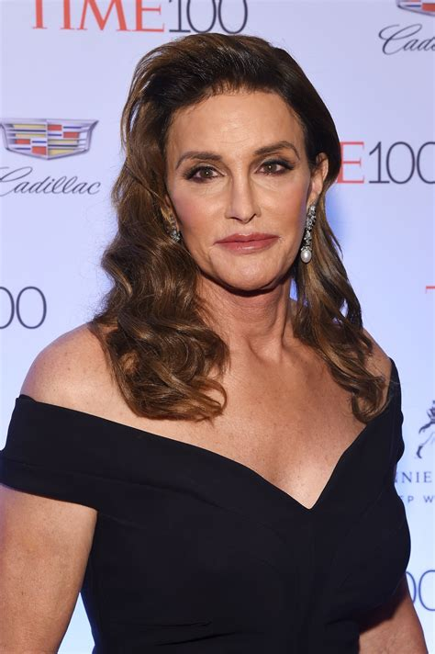
Renée Richards
Competed for the US Open in the 1970s, leading to the Women’s Tennis Association (WTA) and the United States Tennis Association (USTA) withdrawing their support and 25 athletes pulled out of the tournament.
This withdrawal of support led to the Barr body test which identifies a person’s sex chromosomes. Richards refused to be tested and filed a lawsuit after being banned, the court ruled in her favour and ruled her legally female.
Santhi Soundarajan
In 2006 she won a silver medal for India in the 800 meters
The next day she was called in for a blood test and asked to undress. It was announced on Indian national television that she failed the sex test and was stripped of her medal.
Soundarajan was born and raised female but carried a Y chromosome, these transphobic processes and rules are damaging both transgender and cisgendered women’s careers. Now seen publicly as a gender imposter she attempted suicide shortly after returning to India.
Caitlyn Jenner
In 2015, Jenner came out as Caitlyn after winning an Olympic gold medal in the decathlon
Jenner doesn’t support transgender girls participating in girls sport and often attacks trans people and the LGBTQ+ community to build her brand.
Charlotte Clymer argues that Republicans accept her as they look beyond her trans identity due to her whiteness and her wealth in conditional acceptance.

Slide 3

In 2021, Florida lawmakers have advanced a bill that bans trans athletes from school sports and also requires schools to perform an “examination” to verify a student’s genitals in some cases.
The continuation of “examinations” on transgender people and transgender children from the 1960s shows that society’s attitude towards transgender people haven’t changed, some laws have but these checks and endangering young trans people is a common theme throughout history.
Intersex people are not allowed to compete in the Olympics but parents of intersex children often have them undergo invasive ‘gender affirming’ surgery at such a young age.
‘intersex people are not rare, but they are widely misunderstood. Based on a medical theory popularized in the 1960s, doctors perform surgery on intersex children – often in infancy – with the stated aim of making it easier for them to grow up “normal.” ‘
This inherent transphobia is carried throughout society and disadvantages transgender people and harms young trans people for societal comfort
Three days ago South Carolina's governor has quietly signed into law a bill that would ban transgender students from playing girls’ or women’s sports in public schools and colleges.
Only mentioning girls and women’s sports shows that these laws just want to maintain control of and oppress women. This claim that the transgender girls have an ‘unfair biological advantage from having been born males’ is a modern example of transmisogyny and reflective of the patriarchal society we’re in.

