Slide 1






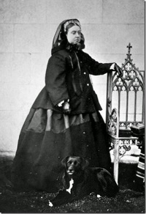
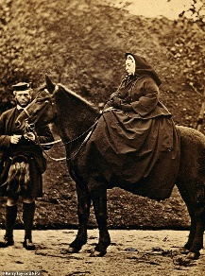


Introduction to fashion in the 1800s – Women’s Clothes
Women’s fashion 1800 onwards
Women’s fashion during the 1800s changed mainly with hemlines, waistlines and the introduction of hats from decorated linen caps and capes.
Dresses were made of linen and lace at the start of the decade, with flouncing and ruching with embellishments to emphasise the backs with a bustle, alongside introduction of trains.
Women’s fashion developed from horsehair and whalebone to the introduction of metal boning in corsets. Alongside the development of a light metal spring hoops for the crinoline (a metal cage supporting the skirt) underneath the hoop skirts in a bell shape, many petticoats in the late 1840s.
By the end of the decade, sleeves got tighter, and necklines got higher with A-line, smaller, skirts. Alongside accessories such as hats with trimming worn squarely on their heads, and parasols.
1840s-1900s Fashion – Victoria & Albert Museum
Queen Victoria’s influence on fashion
Queen Victoria requested that all her clothes and the clothes of courtiers be of British manufacture, boosting the British textile industry. This attention to the British industry heightened the demand of these mass-produced products, increasing output and boosting the British economy. The bell-shaped dress was introduced in the Victorian era, moving away from the wide skirted dresses of the Georgian era and the high waistlines of sleek Regency era dresses.
Victoria remained in mourning attire from 1861, following the death of Prince Albert, until her death in 1901. In the 1800s mourning attire needed to be plain and conservative, with the introduction of more elaborate with strict rules with veils and drop earring became common. In 1840, The Workwoman’s Guide detailed expected mourning times for loss of relatives.
“Advances in textile manufacturing combined with a new consumer appetite for mourning apparel led to the establishment of stores – like Besson & Son in Philadelphia and Jackson’s Mourning Warehouse in Manhattan – that sold ready-made mourning clothes, while department stores like Lord & Taylor added mourning departments.” Jocelyn Sears for Racked.
Queen Victoria c.1860-1870
History of nurse’s uniforms
Nursing was acknowledged as a profession the 1800s with a high collared-shirt, floor-length dress and a bonnet. With influence from nuns' uniforms and the origin of calling a nurse sister.
In the 1900s after Florence Nightingale’s influence on the role, uniforms became more practical and distinguished the different roles and the hierarchy with different colours and symbols.
Florence Nightingale and other 1900s nurses
1800s nurse uniforms

Slide 2

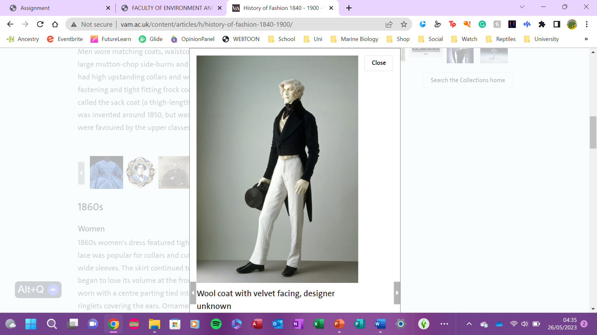

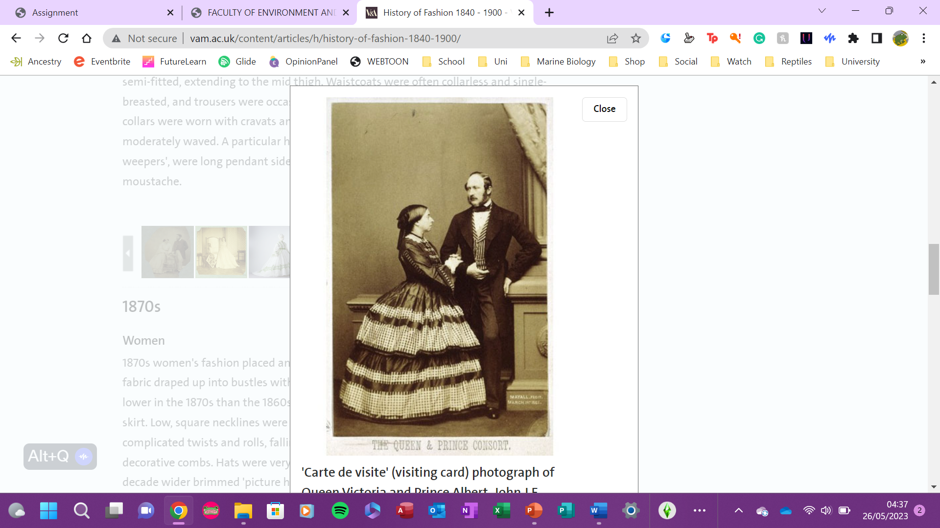


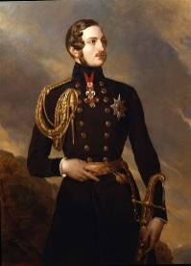
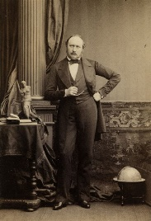
Introduction to fashion in the 1800s – Men’s Clothes
Introduction to men’s fashion 1800 onwards
Men’s fashion in the 1800s, the fitting of suit jackets and coats started off with cinched waists creating an hourglass figure to emulate Prince Albert.
In the 1850s shirts had collars tied with large bowties and bowler hats, also known as the working-class hat while upper class men wore top hats. Jackets and coats length moved down from the hip to mid-thigh and the 1870s introduced semi-fitted jackets buttoned high.
The 1880s focused on the buttoned waist coat rather than the jackets and neckties and bowties around the high collars. By the end of the decade men moved away from frock coats which were popular with more conservative men as the three-piece longue suits gained popularity.
1840s-1900s Fashion – Victoria & Albert Museum
Prince Albert’s influence on fashion
Albert fashioned an hourglass figure with cinched waists that influenced Britain during his reign from 1840 to 1861.
Men’s hairstyles and facial hair in the 1850s, entailed large mutton-chops side-burns and moustaches influenced by Prince Albert. Moustaches were not popular in England until the reign of Prince Albert and were fashionable from 1860.
The Crimean campaign/wars led to soldiers to being infected due to razor cuts leaving many men dead, with the army leaders beginning this trend in order to inspire the troops and prevent more deaths by infection then became popularised in England on the soldiers’ return.
Prince Albert c.1840-1860

