Slide 1
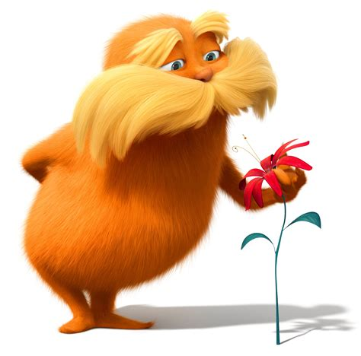

The Image of God in The Lorax (2012)
Shannon Mcmillan

Slide 2
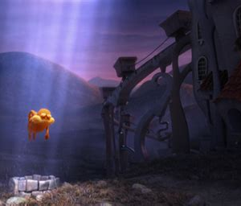
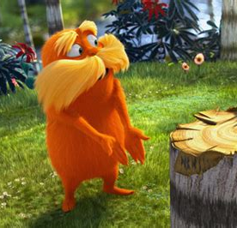
Attributes of God
Transcendent and Immanent Views from afar. Appears out of tree stump to stop further deforestation. Then ascends and descends from the “heavens”.
Faith over observation When the Onceler asks him to show him the powers, he replies “Uh, yeah, I could show you. But that’s not how it works.”
Emphasise on environment and nature
Guardian of the forest. Speaks for the trees.
First appears after the Onceler chops down a tree and mourns it, placing stones around the base with the forest animals’ help, and has a moment of silence.
Continuingly tries to save this valley from deforestation

Slide 3

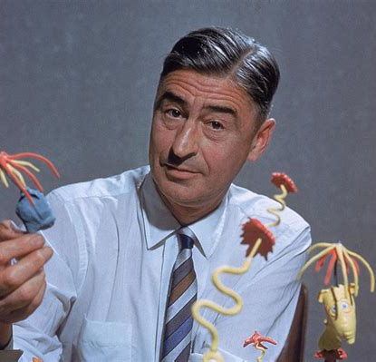
History and Context
Original text written by Dr. Seuss, published in 1971
Dr. Seuss in an interview in 1959 argued that “kids can see a moral coming a mile off and they gag at it”, using children’s media to convey his political views.
The Lorax is set in a totalitarian society inside city walls with a rich man who owns the town and sells fresh air in plastic bottles to boost pollution and sales.
With a critique on capitalism and its effect of nature. IN the flashbacks, with the song ‘How Bad Can I Be’ showing a compilation of the Onceler cutting down all the trees in the valley, the factory expanding, creating air pollution and water pollution. Forcing the animal from the valley to move even the Onceler’s donkey.
Along with the flashback song sung by the people of Greenville ‘Everybody Needs a Thneed’ in the valley paying for a Thneed from the Onceler. Contrasting with present day song sung by the people of now Thneedville ‘Let It Grow,’

Slide 4
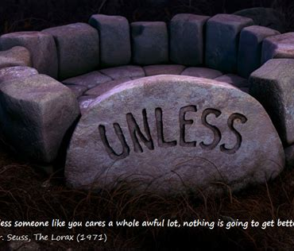

Sources
The Lorax (Illumination, 2012)
The Lorax by Dr. Seuss. Random Literature, 1971, renewed 1999
Fiona MacDonald. BBC Culture, 02/03/2019
‘How Bad Can I Be’. Written John Powell, Cinco Paul and Kool Kojak. Performed by Ed Helms
‘Everybody Needs a Thneed’. Written by John Powell and Cinco Paul. Performed by The 88 and Ed Helms
‘Let It Grow’. Written by John Powell and Cinco Paul. Performed by Fletcher Sheridan, Edie Lehmann Boddicker, Dan Navarro, Claira Nicole Titman, Betty White, Rob Riggle, and chorus
‘UNLESS someone like you cares a whole awful lot, nothing is going to get better. It’s not.’ – Dr. Seuss

