Slide 1

The Legacy of Colonialism has colonialism affected society?
By Leah, Lily, Olly, Tobi and Shannon

Slide 2
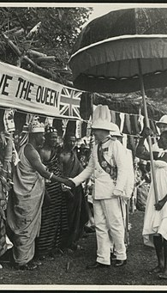
Introduction:
Colonialism can be defined as 'the policy or practice of acquiring full or partial political control over another country, occupying it with settlers, and exploiting it economically.' In this presentation we hope to demonstrate just how much colonialism has affected society today and in the past through exploring topics such as politics, resource extraction, identity, education and borders.
This Photo by Unknown author is licensed under CC BY-SA.

Slide 3

Governance and Political Legacy - Shannon
The influence of colonial-era administrative divisions and institutions on contemporary governance:
The British colonial forces invaded and took over governance of India creating the British Raj, separating the Indian subcontinent into the modern-day Republic of India and the Dominion of Pakistan, and separating the people based on religious beliefs. The British Raj was ruled by Queen Victoria until George VI's rule, from 1858 until Indian independence in 1947.
The British Raj succeeded the British rule via the East India Company, then the British Raj 'unraveled quickly in the 1940s'. Influenced by the 'US foreign policy pressuring the end of Western imperialism, it seemed only a matter of time before India gained its freedom.' During their devolution of power, Britain introduced 'Indianisation' of the administration, which helped India's move towards self-government.
How colonialism shaped the political structures and systems in post-colonial nations:
Many former European colonies can have their present governmental structures traced back to the initial influence of these foreign powers and their methods can still be seen in these countries, such as India and Australia and the continent of Africa.
Post-colonial society in Africa is viewed as living in 'neocolonial, not postcolonial, times’, with many African countries and nations following in the legal footsteps of its former oppressors. Apart from the creation of an authentic self, African societies 'are nothing more than a replica of the colonial states'. This neocolonialism-shaped governance mirrors the West, capitalistic, with one sole representative of people's goals and oppression of opposing political parties. These government and political systems are the most influential legacies left behind by European colonialism. With Eurocentric power structures such as, democracy, secularism, and the rule of law continuing to shape the political structures and systems in post-colonial nations.
Most of 'the African NGO (Non-Governmental Organisations) sector is characterised by external financial dependence and an external orientation'. These NGOs resemble former organisations, and missionaries that European powers used in the colonisation and control of Africa both politically and socially. One of the most influential aspects European colonial powers introduced to Africa was Christian missionary work and Christianity which is the largest religion in Africa. The mission work done by British and European colonial powers was well received by the people of Africa due to the vastness and openness of religion throughout the continent, compared with attempted work in China which led to the execution of missionaries. Those who were sent to Africa were received well, beginning in North Africa and spreading throughout, 'the challenge by Islam and African traditional religions deepened the faith of believers.'
Examining the challenges of nation-building and establishing stable governments after colonial rule:
After the removal of British forces and rule, India and Pakistan were left with financial tensions over the division of assets with India paying 55 crores ("c-roars") with Pakistan sharing the assets.
India in 1948 was left with the 'Refugee Problem' with '5.5 million non-Muslims' moving into India and many Muslims leaving India for Pakistan.
Independent India formed the foundations of Indian Democracy with its first general election, mirroring the Western structure of government with one sole person/party in charge.

Slide 4
Economic Disparities and Resource Extraction- leah
The impact of colonial economic policies on post-colonial economies and case study:
Excessive resource extraction during colonial times caused ongoing ecological, economic and social problems in former colonies. Issues like deforestation, pollution, and soil erosion stemming from these activities have continued to harm local communities. Furthermore, the impact of colonialism has left many nations in ecological devastation with no financial means to address these problems. This is because the persistent control of wealth by colonizers meant that these issues were never properly addressed, leaving a lasting impact on a country's development.
Case study:
A case study demonstrating the effects of this is India's experience under British colonial rule. Animesh discusses how The British systematically drained India's wealth by exploiting resources such as textiles, spices, and agricultural products for their own benefit. This can be referred to as the 'drain theory,' it led to the impoverishment of India and created enduring economic disparities. today, India still grapples with socio-economic inequalities that can be traced back to colonisation, particularly this historical resource extraction.
The role of colonial powers in resource extraction and economic exploitation:
Colonialism played a major role in creating socio-economic disparities through the ruthless exploitation of natural resources in colonies, prioritizing the enrichment of colonial powers at the expense of local populations. Countries such as England would colonialise resource rich countries such as India and Ghana putting them at a disadvantage while taking their resources. The colonialised regions would be drained of their natural resources for economic gain, exploiting the country and their people. Colonial powers would in turn oversee the country economically and politically.
‘A tight economic and political control by the ruling elite of a resource sector dominating an otherwise poor economy leaves little scope for accumulating wealth and status outside state patronage, especially in the case of mineral and oil exporters. As the wealth and power gap between the ruling and the ruled increases, so does the frustration of marginalized groups seeing political change as the only avenue for satisfying their greed and aspirations, or expressing their grievances.’- Lebillon

Slide 5

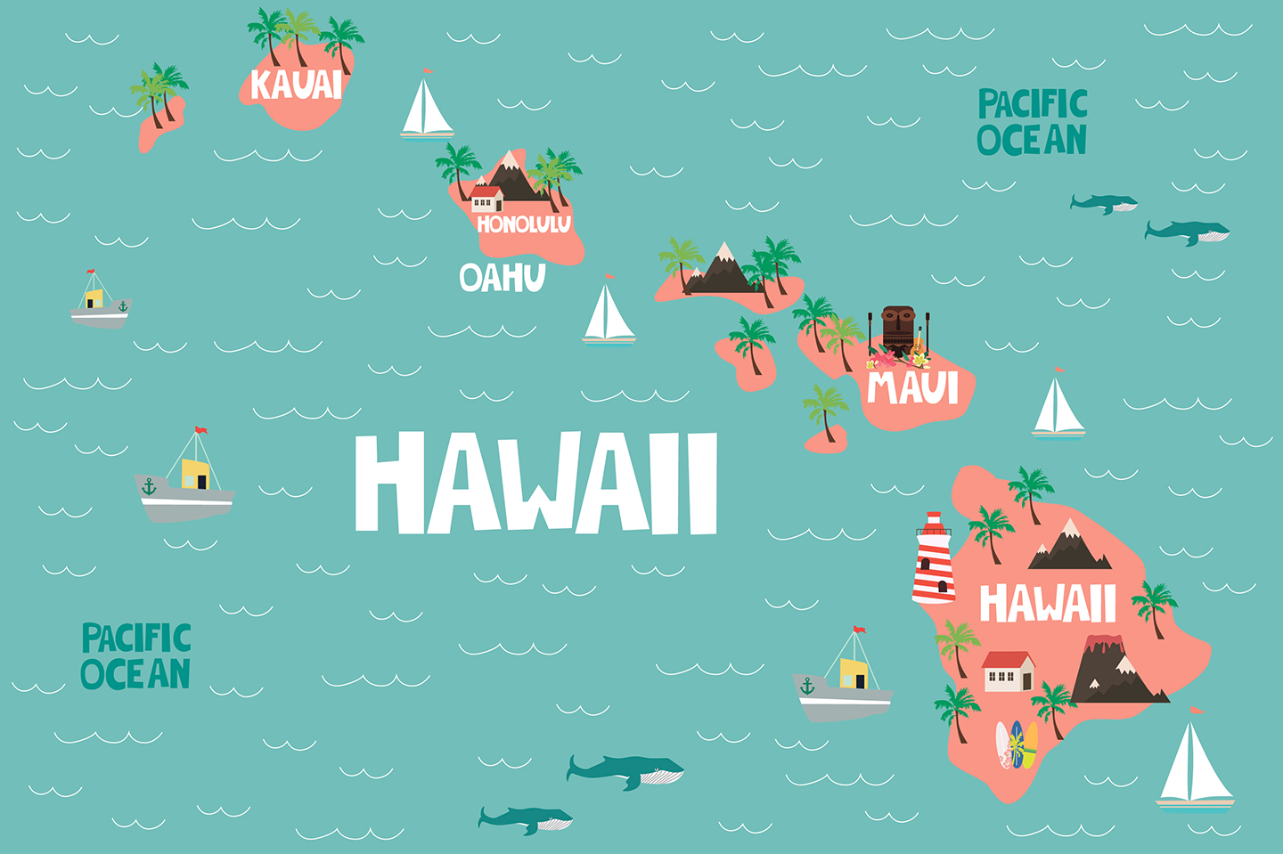
Cultural Influences and Identity- Olly
A common sign of colonialism comes from the blending or assimilation of certain cultural practices and beliefs into the collective belief of the masses or the empire. The acquisition of food, music, clothing etc by the colonial power is practice which has shapes the culture of the invading power in potent and valuable ways for many years even after the connection between the invaded culture and the invading culture is severed. Whilst there is sometimes mutual benefit to these cultural interactions, oftentimes they are not mutually desired and come at the consequence of long-lasting damage to indigenous cultures. The native Hawaiians are an example of this as their being colonized resulted in them losing their land in multiple ways. Both in the physical ownership of land and also in the rapid degradation of the quality of their land thanks to its industrialization, specifically by a man named Sanford Ballard Dole, who pushed for the annexation of Hawaii and James Dole, who took land and used it to grow a business from the favorable climate to grow pineapples. As such, their culture suffered immensely thanks to the defiling of the natural land they cared for as a part of their cultural identity. In more recent years, tourism has taken the place of industrialization in the damaging of the local area and the native populous. In opposition to this, a movement to decolonize Hawaii and reintroduce the Sovereignty of Native Hawaiians has grown in an effort to retake their land and subsequently their cultural identity.
'James Dole is widely known as the first governor of the state of Hawai'i and furthered the economic exploitation of the region through his corporation. The industry was built on the backs of locals, who were paid very little and whose land had been stolen from them'

Slide 6

Education and Knowledge Systems- lily
Within the Bristol community, the organisation, Charting African Resilience Generating Opportunities (CARGO), have created online resources, in order to embrace both African and African descendant stories, both from a historical and individual basis.
These resources are also available online, which have proved helpful with classroom discussions regarding colonialism.
Teacher education is also significant, when schools attempt to discuss colonialism. For example, although a teacher may be qualified to teach history, it’s possible they studied an alternative undergraduate degree, meaning that they may need additional help with learning about colonialism themselves.
Teacher education also enables teachers to create safe spaces, whereby students and teachers alike can discuss the colonial past, including personal experiences.
Societal protest movements, such as Black Lives matter, has also opened up colonialism discussion topics, making them more approachable within educational settings.
Due to colonialism, much of Zimbabwe’s educational system was controlled by the British, middle-class education system, for virtually a century.
Therefore, all educational, cultural traditions were replaced by British norms.
British culture standards had a ‘hegemonic and demonising effect on indigenous education’, meaning that original Zimbabwean education standards were disregarded and viewed as insignificant.
Henceforth, this ignored the ‘social and cultural’ requirements of the community.
During this period of colonialism, spanning just under a century, Zimbabwean people had little say and power over ‘government policies and political decisions that affects the educational system’. (Zvobgo, 1996).

Slide 7

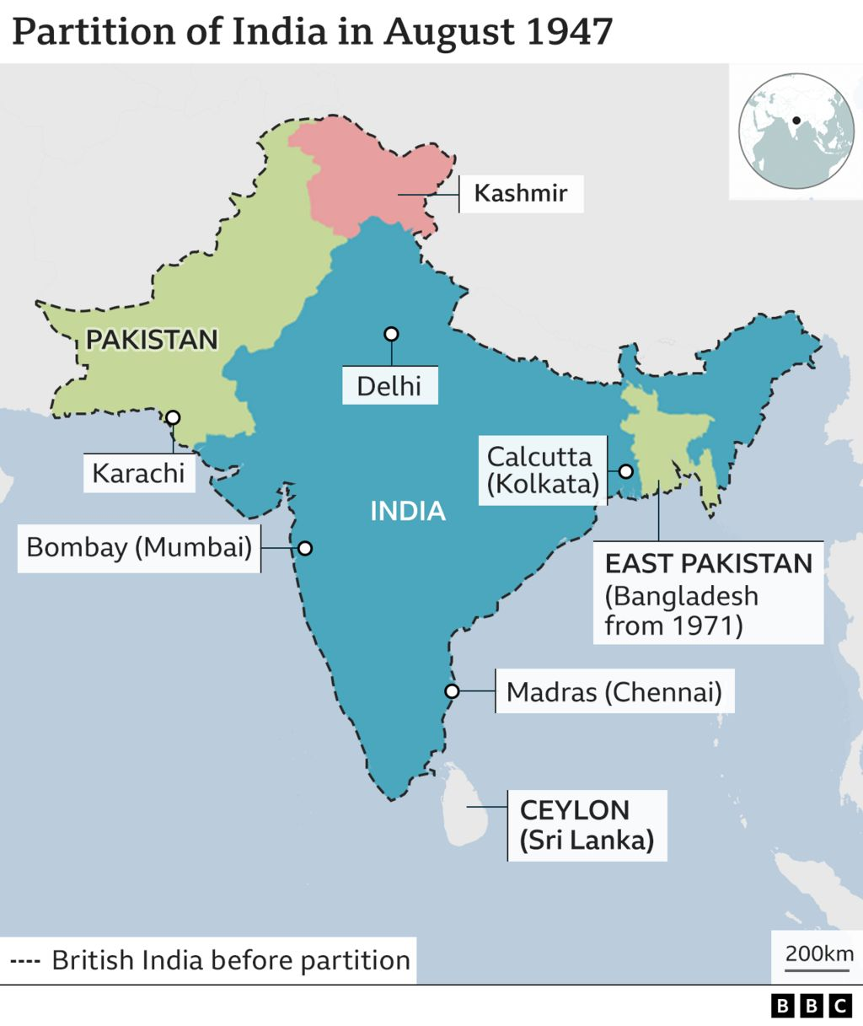
Conflict and Border Issues: Tobi
Why colonial era borders are relevant:
Many current conflicts can have their roots traced back to border disputes that have originated from colonial powers. In addition to these border disputes, some conflicts have been exacerbated by the colonial powers that had control at the time and created an atmosphere in these locations that has allowed conflict to perpetuate to the modern day. One such reason for this is that colonial powers did not rule in a way that sought to understand the pre-existing people of these colonies, rather, they tried to rule based on their world views over these colonies. This often led to colonial powers not understanding religious disputes within the colonies which would make land disputes that had religious causes to be poorly managed by the colonial powers. One such example is India and Pakistan and how the borders that came to be were seemingly arbitrary. Another example of how colonial powers failed to de-escalate border and land disputes is in Palestine and Israel and how the conflict has continued into the modern day.
Examples of current conflicts due to colonial borders and conflicts :
•India and Pakistan were split by colonial Britain arbitrarily on the basis of religion upon which India became Hindu majority and the newly formed Pakistan became majority Muslim. In doing this many Hindus and Sikhs had to travel from Pakistan to India and many Muslims travelled to Pakistan. During this partition, there were disagreements over the borders that the colonial powers had set out and many of the people from these cultural and ethnic groups were targeted violently on either side of the divide on the basis of identity. This had been exacerbated by the way Britain had quickly fled India after the partition, there is still conflict between India and Pakistan fuelled by nationalist sentiment. Nationalist sentiment can be seen as a reaction to colonial forces as the people of a country seek to drive out the occupying force, and when the colonial force divided the nations this was directed at each other as they disputed over the borders that England had created.
•“A defining moment that is neither beginning nor end, partition continues to influence how the peoples and states of postcolonial South Asia envisage their past, present and future.” - Ayesha Jalal describing the partition.
• Israel’s current situation with Palestine is an example of how colonial powers have controlled borders leading to conflict that still persists to this day. Colonial Britain had aimed to quell a revolt in Palestine that sought to end British rule by proposing that they create an exclusively Jewish area, due to the mass Jewish immigration from Europe there had been discontent in Palestine. In 1947 a civil war broke out that led to the establishment of Israel by a militarised Zionist group. Palestine received aid from Jordan at this time which was also controlled by the British. After the formation of Israel, Joran and Palestine merged however only Britain recognized the merger. The US, however, had recognised Israel as a state and Britain had not. This recognition by former and current colonial powers has had lasting consequences to this day as some consider Israel to be a legitimate state and others do not which has allowed a conflict to perpetuate to the current day that has been fuelled by colonial powers. It also shows the failings to negotiate peace and distribute land by colonial forces.

Slide 8
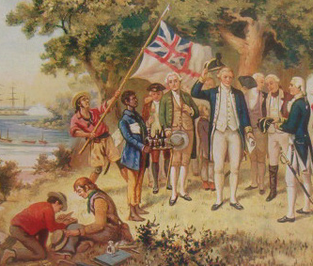
Conclusion
In this presentation, we have articulated how colonialism affects society, both in historical and contemporary concepts. For instance, the way in which education shapes the next generation's perception of colonialism. We also discussed conflict issues, such as the power dynamic between borders, as well as resource extraction, in relation to capitalism; as well as the relationship between colonialism and identity and political links.

Slide 9
Bibliography 1/2
Leah
Gadre, Animesh, ‘Deindustrialisation and the Drain Theory: The Contours of Economic Degradation in British India Gadre’, Munich Personal RePEc Archive (2021) 1-12 <https://mpra.ub.uni-muenchen.de/108977/1/MPRA_paper_108977.pdf> [Accessed 20 october 2023]
Kohn, Margaret and Kavita Reddy, ‘Colonialism’, The Stanford Encyclopedia of Philosophy, (2023) <https://plato.stanford.edu/archives/spr2023/entries/colonialism/> [Accessed October 12 2023]
Lebillon, Philippe ‘The Political Ecology of War and Resource Exploitation’, Studies in Political Economy, 70.1 (2003), 59-95 <https://doi.org/10.1080/07078552.2003.11827130>
Lily
Ismayilova, Lala, Where was the colonial history in our education?, (2021), https://schoolofeducation.blogs.bristol.ac.uk/2021/06/08/where-was-the-colonial-history-in-our-education/, [Accessed 19.10.23]
Shizha, Edward, Kariwo, Michael T, Impact of Colonialism on Education, (2011), Pages 13-26, https://brill.com/display/book/9789460916069/BP000003.xml, [Accessed 19.10.23]
Regmi, Kapil Dev, The enduring effects of colonialism on education: three praxes for decolonizing educational leadership,(2022), https://www.tandfonline.com/doi/pdf/10.1080/13603124.2022.2098379, [Accessed 19.10.23]
Olly
Malfer, Lindsay, The devastating effects of colonization on Hawai'i (2019), The devastating effects of colonization on Hawai'i <https://storymaps.arcgis.com/stories/83474c5d6077492d990b961bab0bcd74> [accessed 7 November 2023]
Kauanui J. KÄhaulani,“Native Hawaiian Decolonization and the Politics of Gender,” American Quarterly, 60(2), (2008) pp. 281–287.
(This is as close to this person's name as I think it is possible to spell on a computer)

Slide 10
Bibliography 2/2
Tobi
‘Israel’s Borders Explained in Maps’, BBC News, 15 September 2020, section Middle East <https://www.bbc.com/news/world-middle-east-54116567> [accessed 7 November 2023]
‘Partition: Why Was British India Divided 75 Years Ago?’, BBC News, 14 August 2022, section India <https://www.bbc.com/news/world-south-asia-62467438> [accessed 6 November 2023]
Weiss, Richard S., The Emergence of Modern Hinduism: Religion on the Margins of Colonialism, 1 online resource (222 pages) vols (Berkeley, CA: University of California Press, 2019) <https://www.jstor.org/stable/10.2307/j.ctvr7fcbm> [accessed 7 November 2023]
‘Why Was British India Partitioned in 1947? Considering the Role of Muhammad Ali Jinnah’ <https://www.history.ox.ac.uk/why-was-british-india-partitioned-in-1947-considering-the-role-of-muhammad-ali-0> [accessed 7 November 2023]
Shannon
Parashar, Swati and Schulz, Micheal. 'Colonial Legacies, Postcolonial 'Selfhood' and the (Un)doing of Africa', Third World Quartley, (2021) Volume 42, Issue 5, pp.867-881.<https://www.tandfonline.com/doi/full/10.1080/01436597.2021.1903313>
The African Bible. Christian History, The History of Christianity in Africa // African Study Bible. (2019), [Accessed 09.11.23] <https://africa.thegospelcoalition.org/article/history-christianity-africa/>
Kaul, Dr. Chandrika. 'From Empire to Independence: The British Raj in India 1858-1947.' (2011) <https://www.bbc.co.uk/history/british/modern/independence1947_01.shtml>
Toppr. 'India After Independence' [Accessed 09.11.23] <https://www.toppr.com/guides/history/india-after-independence/india-after-independence/#Phase_1_1947-_1967>

