Slide 1
Bamyan, Afghanistan
Shannon Mcmillan

Slide 2
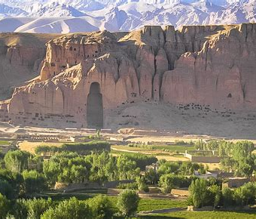
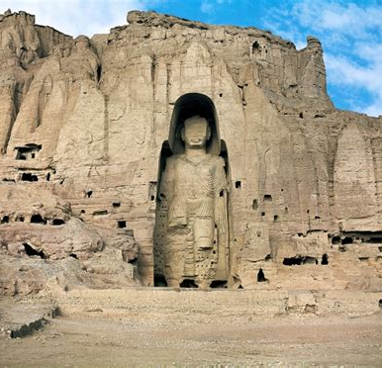
Bamyan
*Bamyan also referred to as the “Shining Light” and “Valley of Gods” is one of the oldest cities in central and South Asia.
*Inhabited since the third century BC, Bamyan is located in the central highlands, known as the peaceful Hazarajat or Hazaristan, Afghanistan.
*Bamyan lies at the heart of ancient silk road, once connecting Chinese commerce with Europe and the broader Mediterranean region
*Its population of approximately 70,000 people makes it the largest city in Hazarajat

Slide 3
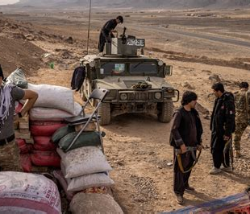

The Taliban in Afghanistan
Immediately after storming to power in Afghanistan last August, the Taliban renewed their assault on the country’s rich pre-Islamic heritage by looting archaeological treasures in Bamiyan province, in Afghanistan’s central highlands. They zeroed in on the site of the giant Buddhas that, in the Taliban’s first incarnation two decades ago, became an international symbol of the group’s depravity as it declared the 1,400-year-old statues “idolatrous” before proceeding to dynamite them.
One of the men behind one of history’s most heinous cultural crimes was Mullah Abdullah Sarhadi, now the Taliban’s de facto governor of Bamiyan province. Since the Taliban’s return, he has been overseeing the plunder of protected Buddhist antiquities, according to archaeologists and experts with knowledge of destructive activity. He is also implicated in the massacre of Hazaras, who regard Bamiyan as their homeland, dating back to the last time the Taliban ruled, from 1996-2001.

Slide 4
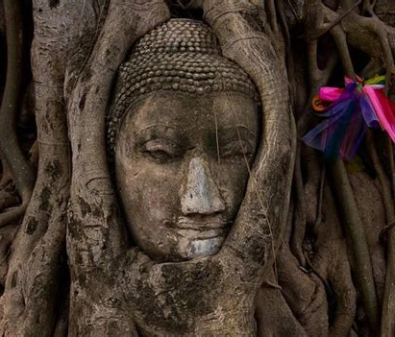
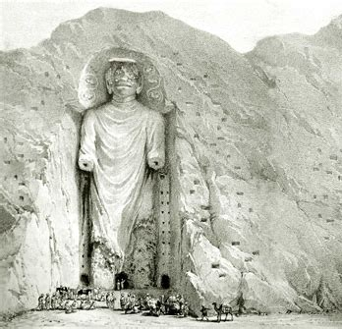
Giant Buddhas of Bamyan
Believed to be the burial site of important saints, Bamiyan was a Buddhist centre under the Kushan Emperors.
The famous Giant Buddhas were carved into the cliffs of Bamiyan between the 3rd and the 6th centuries CE.
Historical documents mention that celebrations were held every year attracting numerous pilgrims eager to pay devotion and make their offerings to the Buddhas, the Western “Big” Buddha, a 55 metre-high “Salsal Buddha,” and the Eastern “Small” Buddha, a 38 metre-high “Shamama Buddha.” Although the statues were destroyed in 2001 by the Taliban, the site is a historical complex with outstanding universal value and has been classified as such by UNESCO.
Stairways that lead to the head of the Buddhas, presumably used by the pilgrims to pray and bring their offerings, and over 500 caves with traces of murals and carved decorations from over a thousand years await visitors.

Slide 5
Sources
https://bamyanfoundation.org/sister-cities-initiative
https://unhabitat.org/sites/default/files/download-manager-files/State%20of%20Afghan%20Cities%202015%20Volume_1.pdf#page=30
https://foreignpolicy.com/2022/06/07/taliban-target-buddhist-heritage-afghanistan/
https://web.archive.org/web/20211129235250/https://bamiyanculturalcentre.org/visit-bamiyan

